Slide 1
Alumni Network: An Academic Portal using Machine Learning

Slide 2
CONTENTS OF THE PRESENTATION
Abstract.
Objective
Problem Statement.
Scope.
Introduction
Proposed System.
Project flow diagram.
Resource Requirements.
Literature Review
Methodology
Modules
UML diagrams
References

Slide 3
ABSTRACT
The Alumni Network: An Academic Portal using Machine Learning is an innovative web platform designed to enhance engagement between alumni and their academic institution. The system enables alumni to register, interact with fellow alumni, participate in academy events, and stay updated with academy news. Administrators can manage alumni data, approve registration and event requests, and update academy content, such as events, news, and galleries. The platform also integrates an advanced chatbot powered by Long Short-Term Memory (LSTM) networks to efficiently handle user inquiries. This portal serves multiple user roles: Admin, Alumni, and Guests. Alumni can register, chat with others via the chatbox, and book events, while prospective users can explore the gallery, news, and interact with the chatbot for information about the academy. Admins handle backend processes, such as managing alumni registrations and event requests. The system’s user-friendly design, coupled with automated features like the chatbot and email notification system, creates an efficient and streamlined experience for both administrators and alumni. Additionally, the system ensures security through robust authentication and validation mechanisms, safeguarding user data and interactions. This project provides a seamless digital platform for strengthening alumni relationships, enhancing event management, and fostering ongoing engagement between alumni and their alma mater.

Slide 4
Objective of the Project
The objective of this project is to create a seamless, secure platform for alumni to engage, administrators to manage data, and users to explore academy content, enhanced by an LSTM-based Chabot.

Slide 5
Problem Statement
Educational institutions often struggle to maintain ongoing engagement with their alumni and effectively manage alumni data, event participation, and communication. Existing platforms lack streamlined tools for alumni networking and interaction, administrative oversight, and automated assistance. This project aims to address these challenges by developing a centralized Alumni Network Portal using Machine Learning, incorporating advanced chatbot features to facilitate alumni communication, event management, and overall engagement, while ensuring secure data handling and user authentication.

Slide 6
Scope
The scope of the "Alumni Network: An Academic Portal using Machine Learning" project involves creating a comprehensive web platform to enhance alumni engagement with their academic institution. The system enables alumni registration, event participation, and networking through secure chat functionalities. Administrators can manage alumni data, approve registrations, oversee event bookings, and update academy content such as news and galleries.
A key feature of the platform is the integration of a machine learning-powered LSTM chatbot, which provides automated assistance to both alumni and visitors, answering queries about the academy, courses, and events. The chatbot reduces manual administrative tasks, offering a seamless user experience.
The platform ensures data security and integrity with robust authentication mechanisms, protecting alumni communication and personal information. Additionally, automated email notifications keep alumni informed about their registration and event booking statuses, enhancing communication efficiency.
Future enhancements could include personalized event recommendations, advanced analytics to track alumni engagement, and a mobile-friendly interface for improved accessibility. The platform serves as a centralized, scalable solution for institutions to maintain ongoing engagement with their alumni, streamline administrative workflows, and foster a long-term connection with their alumni community.

Slide 7
Introduction
The "Alumni Network: An Academic Portal using Machine Learning" is a cutting-edge web platform designed to foster stronger connections between alumni and their alma mater. Educational institutions often face challenges in maintaining consistent and meaningful engagement with their alumni due to the lack of centralized systems for interaction, event participation, and information sharing. Alumni play a crucial role in contributing to an institution’s growth through mentorship, networking, and even potential funding, making it essential for academic institutions to establish long-term relationships with their graduates. This project aims to address these challenges by offering a comprehensive solution that brings together alumni, administrators, and visitors in a streamlined, user-friendly portal.At the heart of this system are three primary user roles: Alumni, Admin, and Guests/Visitors. Alumni can register on the platform, subject to admin approval, and gain access to features such as interacting with fellow alumni, viewing academy events, and booking event participation. This feature promotes alumni engagement, networking, and a sense of community. Additionally, alumni receive email notifications regarding the status of their event bookings, ensuring clear communication between alumni and the institution.The Admin module is designed to handle backend processes efficiently, reducing the manual workload. Admins can approve or reject alumni registration requests, manage event bookings, and update academy content, including galleries, news, and event details.

Slide 8
Introduction
The admin role ensures the smooth functioning of the platform, allowing the institution to stay up-to-date with its alumni network.One of the most innovative features of the platform is the LSTM-based chatbot. This machine learning-powered chatbot is accessible to all users, including non-registered visitors, providing instant responses to inquiries about the academy. From information on course offerings to fee structures and event schedules, the chatbot reduces the administrative burden of responding to repetitive questions, allowing administrators to focus on more critical tasks. The use of Long Short-Term Memory (LSTM) in the chatbot ensures efficient processing of user queries, offering relevant and accurate responses.For Guests/Visitors, the platform provides access to view gallery images, academy news, and information about achievers. This not only offers a glimpse into the academy’s highlights but also encourages prospective alumni to engage with the institution. Visitors can also interact with the LSTM chatbot for general inquiries and later register to become alumni.In summary, the Alumni Network: An Academic Portal using Machine Learning provides a centralized platform that enhances alumni engagement, automates administrative tasks, and ensures secure data handling. The platform fosters long-term alumni relations through its innovative chatbot, streamlined event management, and continuous communication, ultimately strengthening the connection between the institution and its graduates.

Slide 9
Existing System
In many educational institutions, alumni engagement and management are often handled through basic websites, social media groups, or manual processes such as email communications and event coordination. These systems typically lack integration, automation, and a dedicated platform for seamless alumni interaction.
Disadvantages of existing systems
Manual Processes: Alumni data management, event booking, and communication often rely on manual effort, leading to delays and errors.
Lack of Engagement: Alumni interaction is limited to social media or isolated channels, which do not foster continuous engagement with the institution.
No Centralized Platform: Information about alumni, events, and academy news is scattered, making it hard to access relevant updates efficiently.
Poor Data Management: The absence of a proper system for alumni data management results in unstructured or outdated databases

Slide 10
Proposed System
The proposed system, Alumni Network: An Academic Portal using Machine Learning, is a dedicated web platform that centralizes alumni registration, event management, and communication. The platform features an LSTM-based chatbot for automated assistance, a chatbox for alumni interaction, and an admin panel for managing alumni requests and academy updates.
Advantages of Proposed System
Centralized Platform: Alumni, admins, and users can access all necessary information—alumni data, event bookings, academy news, galleries—through a single, organized platform.
Enhanced Alumni Engagement: The chatbox allows alumni to communicate and network with each other, fostering a sense of community and long-term engagement.
Streamlined Admin Management: Administrators can easily manage alumni registrations, event bookings, and content updates, reducing the need for manual oversight.
Email Notification System: Alumni are notified about event registration or booking statuses via automated email notifications, improving communication efficiency.

Slide 11
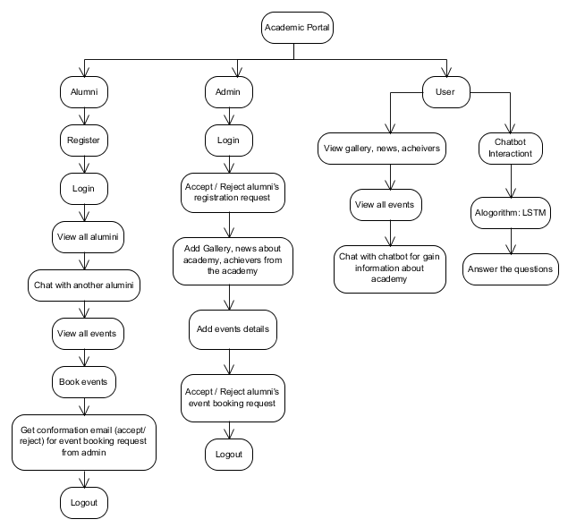
Project Flow

Slide 12
Resource Requirements
01
Hardware
(Processor: I5/Intel Processor, RAM: 8GB (min), Hard Disk: 128 GB, Key Board: Standard Windows Keyboard, Mouse: Two or Three Button Mouse)
Resources
02
Software
(Operating System: Windows 10, Programming Language: Python 3.10.8, IDE: VS Code)
03
Packages/Libraries
(Pandas, Seaborn, flask, mysql-connector

Slide 13
LITERATURE REVIEW
S.NO | YEAR | AUTHORS | TITLE | OUT COMES
1 | 2023 | Lingchen Lynette Dang, BY Advisor, Faculty Wang Preceptor, Zhao Jia, Shilin | ALUMNI INFORMATION COLLECTION AND MANAGEMENT | This thesis automates alumni information collection, analyzes career trajectories using computational methods, and proposes a machine-learning approach for mentor matching, culminating in the prototype web app SSD Connect.
2 | 2023 | P. V, L. S. K, P. Vyshnavi A, M. Ch and S. B. G | Students Community Portal using Machine Learning | The Campus Conversation Portal enables seamless communication between students and faculty, using support vector machines and feedforward neural networks to provide accurate answers and enhance student comprehension.

Slide 14
LITERATURE REVIEW
S.NO | YEAR | AUTHORS | TITLE | OUT COMES
3 | 2022 | Raphael Enihe, Victor Omopariola | Alumni Portal System for Nigerian Universities | This study aims to develop an alumni management system for Nigerian universities, enhancing communication, fundraising, and networking while addressing deficiencies in existing systems through design science research.
4 | 2021 | Agbogun, J. B. and Akpan, Vincent Andrew | On the Development of Machine Learning Algorithms for Information Extraction of Structured Academic Data from Unstructured Web Documents | This paper presents a machine learning approach for extracting structured academic data from unstructured web documents, validated using Kogi State University data, highlighting challenges, methods, and achievements.

Slide 15
Methodology
1. Backend Development
Admin Module: Development of functionalities to manage alumni registrations, event approvals, and updates to academy news, galleries, and achiever details.
Alumni Module: Creation of a secure login and dashboard for alumni to interact with the system, including viewing other alumni, booking events, and engaging in one-on-one chat via a chatbox.
User Module: Enabling guest users to explore public academy content and interact with the chatbot for general inquiries about the institution.
Email Notification System: Implementing an automated system to send email notifications to alumni regarding event registration and booking status.
2. Chatbot Development (LSTM-Based)
LSTM Network for Chatbot: The chatbot uses Long Short-Term Memory (LSTM), a type of recurrent neural network, to handle user queries related to the institution, courses, and events. The model is trained on a dataset of frequently asked questions (FAQs) related to alumni networks and general academy information, allowing the chatbot to provide relevant and accurate responses.

Slide 16
Methodology
2. Chatbot Development (LSTM-Based)
Natural Language Processing (NLP) techniques, such as tokenization and word embeddings, are used to process the user's input before feeding it into the LSTM network.
Model Training: Data is pre-processed by cleaning, tokenizing, and padding text sequences, followed by training the LSTM network using backpropagation through time (BPTT). Hyperparameters such as learning rate, batch size, and sequence length are optimized for accurate and responsive output.
3. Front-End Development
User Interface Implementation: Building the front-end components for alumni, admin, and guest interactions. The front-end communicates with the back-end APIs for data retrieval and submission.
Chatbox for Alumni: Developing a real-time, secure chatbox feature for alumni to interact with each other. Messages are stored in the database and displayed in a user-friendly interface.
Chatbot Integration: Embedding the LSTM-powered chatbot into the front end, accessible by both registered users and guests. The chatbot is integrated to answer queries about the academy, available courses, and events.

Slide 17
UML DIAGRAMS
UML stands for Unified Modelling Language. UML is a standardized general-purpose modelling language in the field of object-oriented software engineering. The standard is managed, and was created by, the Object Management Group.
The goal is for UML to become a common language for creating models of object-oriented computer software. In its current form UML is comprised of two major components: a Meta-model and a notation. In the future, some form of method or process may also be added to; or associated with, UML.

Slide 18
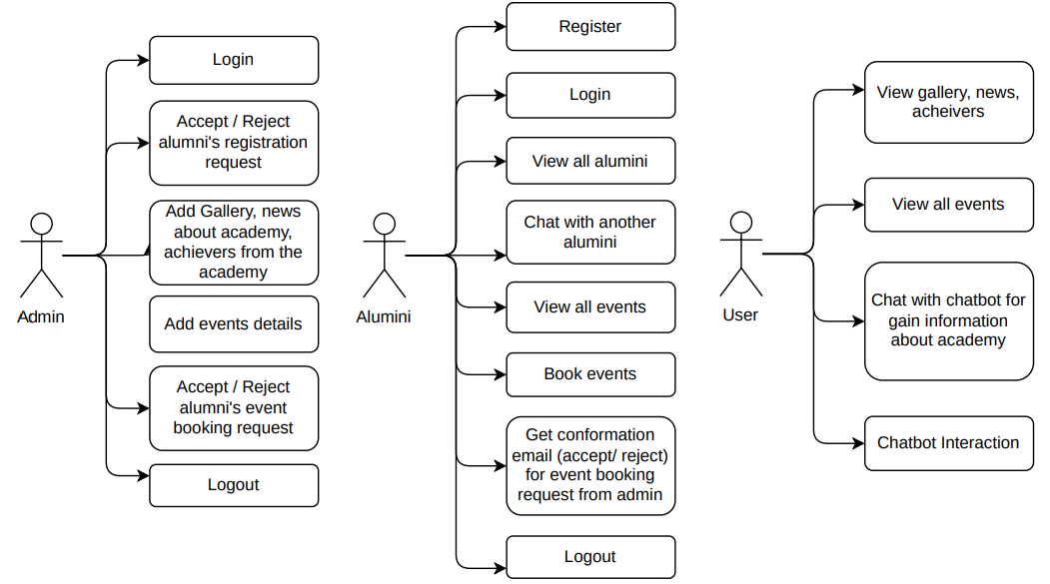
UML DIAGRAMS
A Use case diagram in the Unified Modeling Language (UML) is a type of behavioral diagram defined by and created from a Use-case analysis.

Slide 19
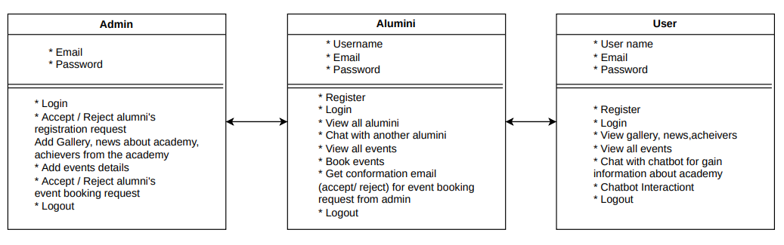
UML DIAGRAMS
A Class Diagram in the Unified Modeling Language (UML) is a type of static structure diagram that describes the structure of a system by showing the system's classes, their attributes, operations (or methods), and the relationships among the classes. It explains which class contains information.

Slide 20
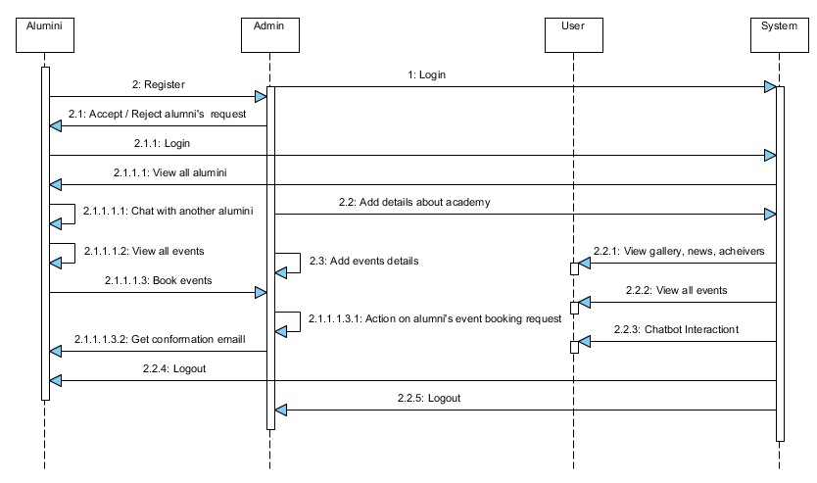
UML DIAGRAMS
A Sequence Diagram in Unified Modeling Language (UML) is a kind of interaction diagram that shows how processes operate with one another and in what order. It is a construct of a Message Sequence Chart. Sequence diagrams are sometimes called event diagrams, event scenarios, and timing diagrams.

Slide 21
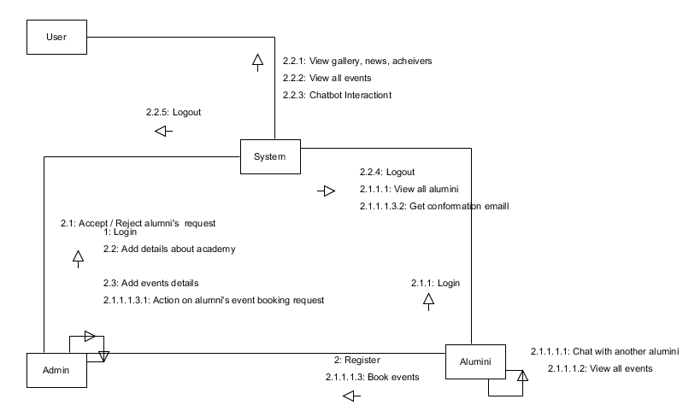
UML DIAGRAMS
In Collaboration Diagram the method call sequence is indicated by some numbering technique as shown below. The number indicates how the methods are called one after another. We have taken the same order management system to describe the collaboration diagram. The method calls are similar to that of a sequence diagram. But the difference is that the sequence diagram does not describe the object organization whereas the collaboration diagram shows the object organization.

Slide 22
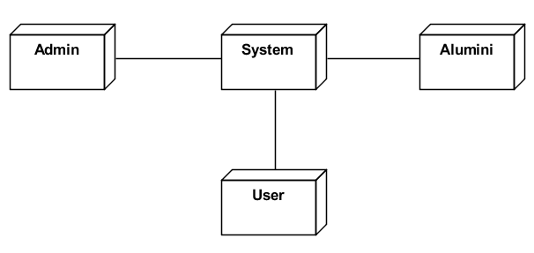
UML DIAGRAMS
A Deployment Diagram represents the deployment view of a system. It is related to the component diagram. Because the components are deployed using the deployment diagrams. A deployment diagram consists of nodes. Nodes are nothing but physical hardware’s used to deploy the application.

Slide 23
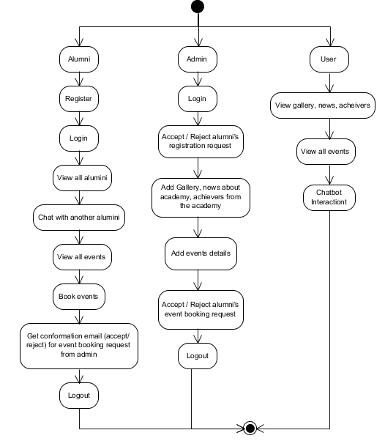
UML DIAGRAMS
Activity Diagrams are graphical representations of workflows of stepwise activities and actions with support for choice, iteration and concurrency. In the Unified Modelling Language, activity diagrams can be used to describe the business and operational step-by-step workflows of components in a system. An activity diagram shows the overall flow of control.

Slide 24
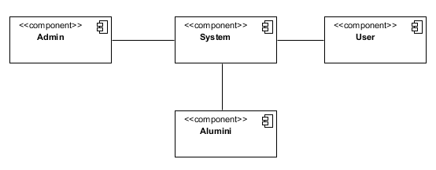
UML DIAGRAMS
A Component diagram, also known as a UML component diagram, describes the organization and wiring of the physical components in a system. Component diagrams are often drawn to help model implementation details and double-check that every aspect of the system's required function is covered by planned development.

Slide 25
UML DIAGRAMS
An Entity–relationship model (ER model) describes the structure of a database with the help of a diagram, which is known as Entity Relationship Diagram (ER Diagram). An ER model is a design or blueprint of a database that can later be implemented as a database. The main components of E-R model are: entity set and relationship set.
An ER diagram shows the relationship among entity sets. An entity set is a group of similar entities and these entities can have attributes. In terms of DBMS, an entity is a table or attribute of a table in database, so by showing relationship among tables and their attributes, ER diagram shows the complete logical structure of a database. Let’s have a look at a simple ER diagram to understand this concept.

Slide 26
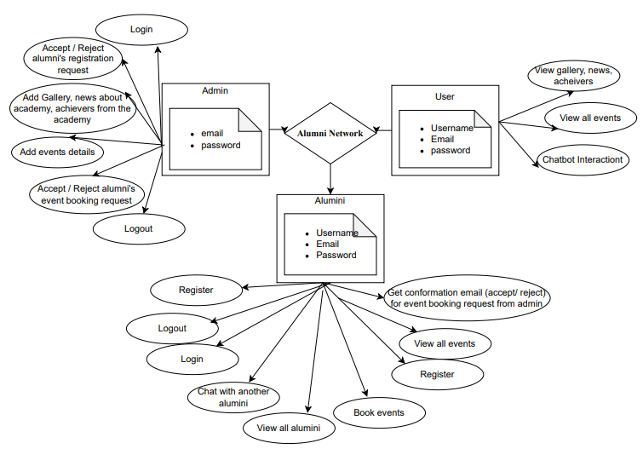
ERD Diagram

Slide 27
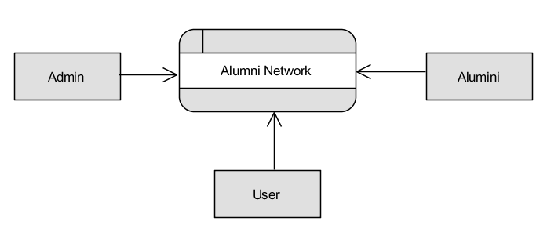
DFD DIAGRAMS
Context Level Diagram

Slide 28
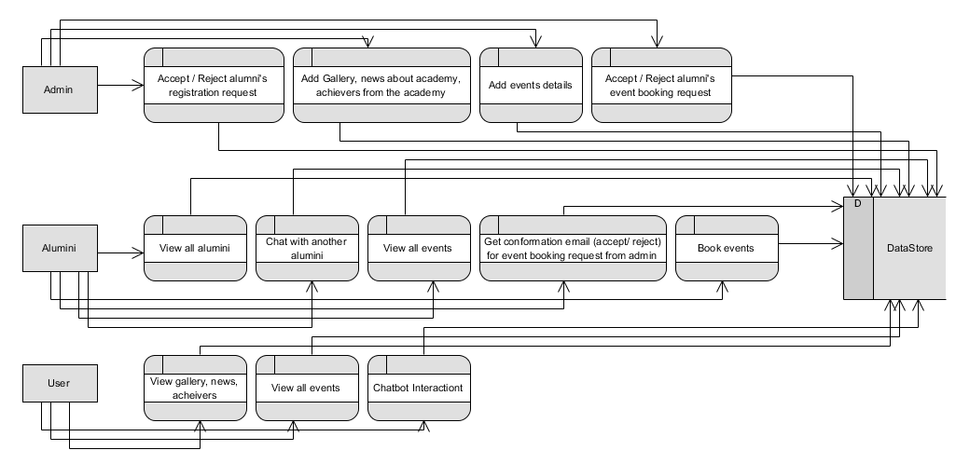
DFD DIAGRAMS
Level 1 Diagram

Slide 29
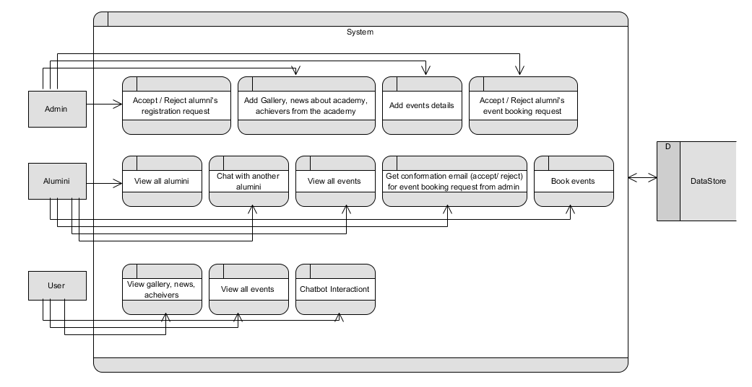
DFD DIAGRAMS
Level 2 Diagram

Slide 30
MODULES
Admin Modules
O Manage alumni registrations: Approve or reject alumni registration requests.
O Manage event bookings: Review and accept or reject alumni event booking requests.
O Update academy content: Add and manage events, news, gallery images, and information about academy achievers.
O Email notifications: Automatically send email notifications to alumni regarding the status of event booking requests.
O View alumni and event data: Admin can view registered alumni details and event booking statuses.
2. Alumni Modules
O Registration: Alumni can submit a registration request, which requires admin approval.
O Login: After admin approval, alumni can log in to their personalized dashboard.

Slide 31
MODULES
2. Alumni Modules
O Explore other alumni: Alumni can view profiles of other alumni registered in the system.
O Chatbox: Alumni can interact with other alumni using a one-on-one chatbox system.
O Event booking: Alumni can view academy events and send booking requests to the admin.
O Email notifications: Receive email notifications about the status of event bookings.
O Logout: Alumni can securely log out of their session
3. User Module (Guest/Visitor):
O Explore academy content: Users can browse gallery images, academy news, and information about achievers.
O View event details: Guests can view upcoming academy events without logging in.
O Chat with the LSTM chatbot: Guests can use the chatbot to get general information about the academy, such as courses, fees, and more.

Slide 32
MODULES
3. User Module (Guest/Visitor):
O Register as an alumni: Guests who are interested in alumni-related activities can register to become alumni
4. LSTM-Based Chatbot Module:
O Automated user assistance: The chatbot answers user queries regarding academy details such as fee structure, courses, and more.
O Accessible by all users: The chatbot is available on the homepage and can be accessed by both registered and non-registered users.
5. Chat box Module:
O Alumni communication: Allows alumni to chat and interact with each other one-on-one.
O Secure interaction: Messages exchanged between alumni are stored securely in the database.

Slide 33
REFERENCES
[1] Alumni Relationship Management Using Technology: Leveraging Digital Platforms for Alumni Engagement, Journal of Educational Technology & Society, 2020.
[2] Design and Implementation of an Alumni Management System, International Journal of Computer Science and Network Security, 2019.
[3] Artificial Intelligence-Powered Chatbots in Higher Education: A Study on Usability and User Experience, Journal of Interactive Learning Research, 2021.
[4] Using Long Short-Term Memory (LSTM) Networks for Question-Answering Systems, Journal of Machine Learning Research, 2020.
[5] The Role of Chatbots in Education: A Study on the Use of AI-Powered Bots for Student Interaction, Educational Technology & Society, 2019.

Slide 34
REFERENCES
[6] A Web-Based Alumni Portal for Enhancing Engagement, International Journal of Web-Based Learning and Teaching Technologies, 2018.
[7] Machine Learning Applications in Education: A Review, IEEE Access, 2021.
[8] Implementation of Secure Chat Systems Using Machine Learning in Alumni Networks, Journal of Applied Machine Learning, 2020.
[9] Alumni Engagement: Building a Lifelong Relationship through Digital Platforms, Journal of Higher Education Outreach and Engagement, 2020.
[10] Enhancing User Experience in Educational Chatbots Using LSTM Networks, Journal of Artificial Intelligence in Education, 2020.

Slide 35
THANK YOU !

